Slide 1



PROJECT: COLUMNS PRESENTATION
Prepared by Akif Selim Arslan Bedirhan Karaahmetli Esma Beydili Musa Enes Karakulak
İzmir,TURKEY
May,2022

Slide 2
OUTLINE
Introduction
Progress Summary • Scheduling • Completed Tasks • Incomplete Tasks • Additional Improvements
Problems Encountered
Algorithms and Solution Strategies
Screenshots
Conclusion
References

Slide 3
1.
INTRODUCTION

Slide 4
Introduction
The aim of the game is to get the maximum score by creating sequential sets with the transfer, an ordered set (1-10) or a reverse ordered set (10-1) is created in a column.
These numbers must be ordered and there must be no other numbers in the column.

Slide 5
Introduction
The player gets 1000 point for each set ordered. The completed set is destroyed.
For maximum points, the player must play with as few transfers as possible.
The player can finish the game by collecting 5 sets in a row.

Slide 6
2. PROGRESS SUMMARY

Slide 7
2.1 – Scheduling
1st Week | Design of classes, data structures, menu, and screen | Load operations
2nd Week | Box implementation | Initial distribution of the box on the screen
3rd Week | High Score Table
4th Week | Columns | Transfer operations
5th Week | Remaining parts of the game | Debugging/ Testing

Slide 8
2.2 – Completed Tasks
All tasks were successfully accomplished in strict accordance with the weekly schedule.

Slide 9
2.3 – Incomplete Tasks
Everything is completed successfully.

Slide 10
2.4 - AdditionalImprovements
Info box was added that gives information because of the player's wrong movements.

Slide 11
3. PROBLEMS ENCOUNTERED

Slide 12
3 – Problems Encountered
If a column is empty, the cursor cannot pass through that column.
Null Pointer Exception.

Slide 13
4. ALGROTIHMS AND SOLUTION STRATEGIES

Slide 14










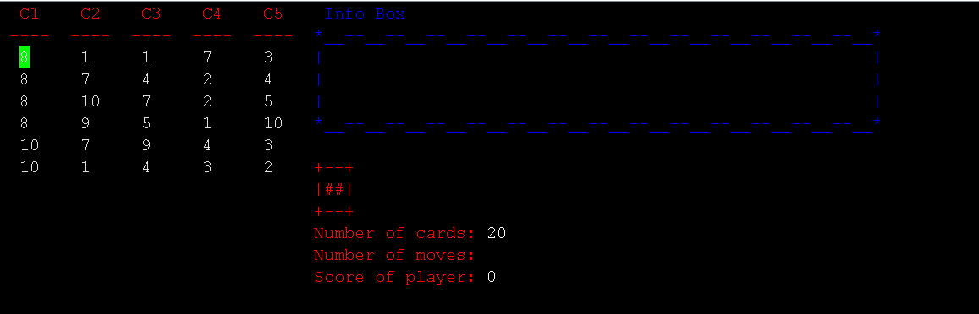
Algorithms and Solution Strategies
5
5
5
5
5
5
5
5
5
5
At the beginning of the game, the numbers are distributed in the box, 6 to each column.

Slide 15
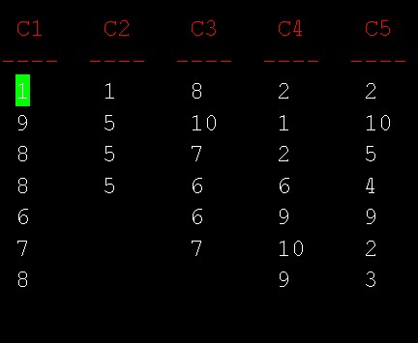

Algorithms and Solution Strategies
6
7
8
Selecting the numbers in the columns and returning them as a number node
6 - 7 = 7 - 8
6 – 6 ≠ 6 – 7

Slide 16
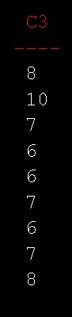
Algorithms and Solution Strategies
6
6
7
8
If the difference between the first number in the selected set and the last number of the target column is 1, 0 or -1, the selected numbers can be moved to that column.
7
7 – 6 = 1

Slide 17
5. SCREENSHOTS

Slide 18
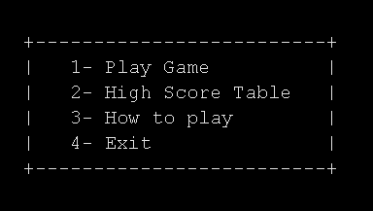

Slide 19
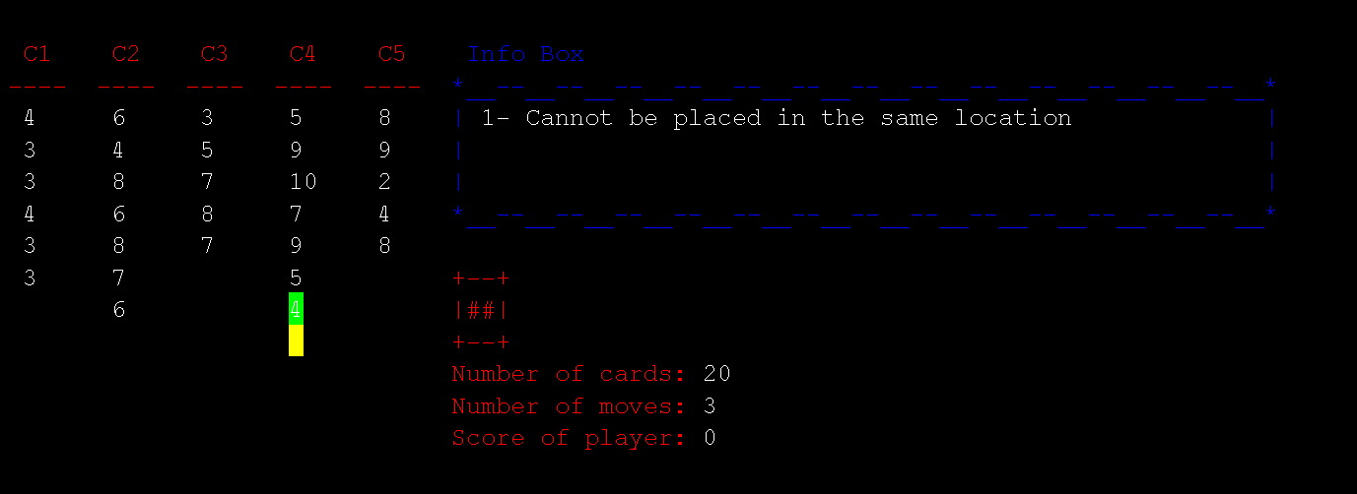

Slide 20
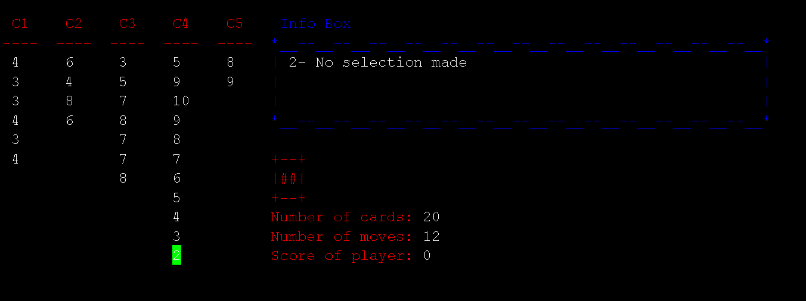

Slide 21
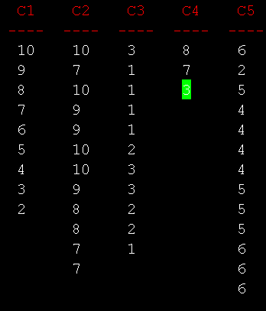
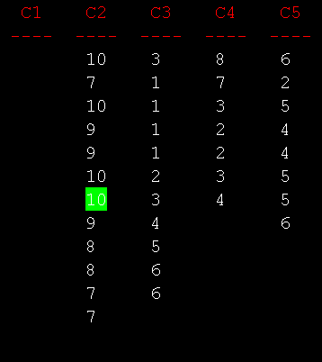

Slide 22
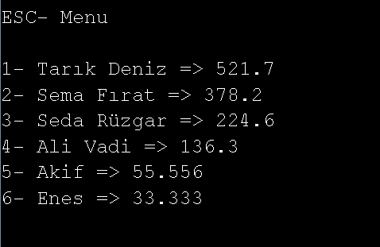

Slide 23
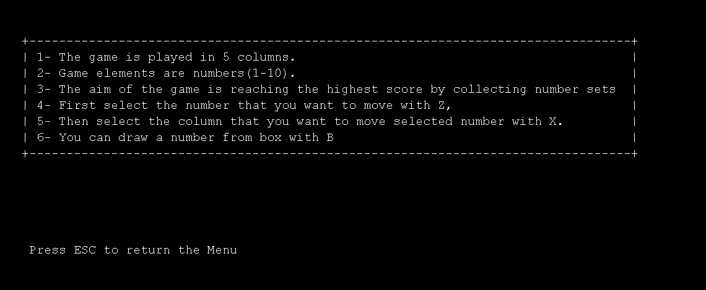

Slide 24
6. CONCLUSION

Slide 25
Conclusion
With this project, we learned a lot about object-oriented programming in the Java programming language.
We learned how to use "Linked Lists".
We completed the project on time by doing what was asked of us.

Slide 26
7. REFERENCES

Slide 27
References
C., P. D. C., Kee, K. D. B., & Lee, D. (1998). Object-oriented programming and Java. Springer.
Standish, T. A. (1998). Data structures in Java. Addison-Wesley.
Standish, T. A. (1998). Data structures in Java. Addison-Wesley.
slidescarnival.com (Presentation template by Jimena Catalina).

Slide 28
ANY QUESTIONS ?

